Slide 1

Docker Container Lifecycles - Problem or Opportunity?

Slide 2

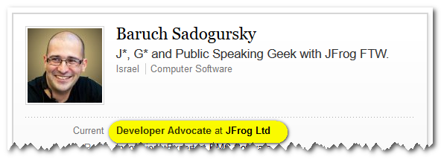
About your speaker
@jbaruch
github.com/jbaruch
linkd.in/jbaruch
stackoverflow.com/users/402053/jbaruch
Notes:
CURRENT – JB NEXT - YOAV

Slide 3
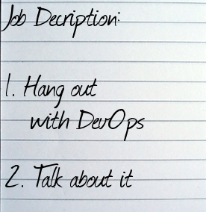
Developer who?

Slide 4
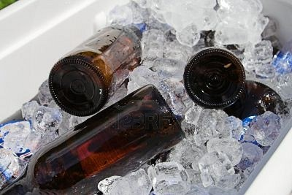
Developer who?

Slide 5
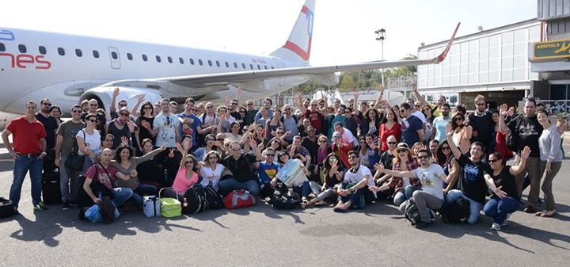
What Frog?

Slide 6
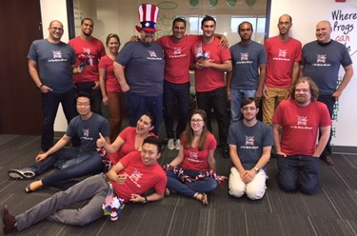
What Frog?

Slide 7

What Frog?

Slide 8

What Frog?

Slide 9


Slide 10
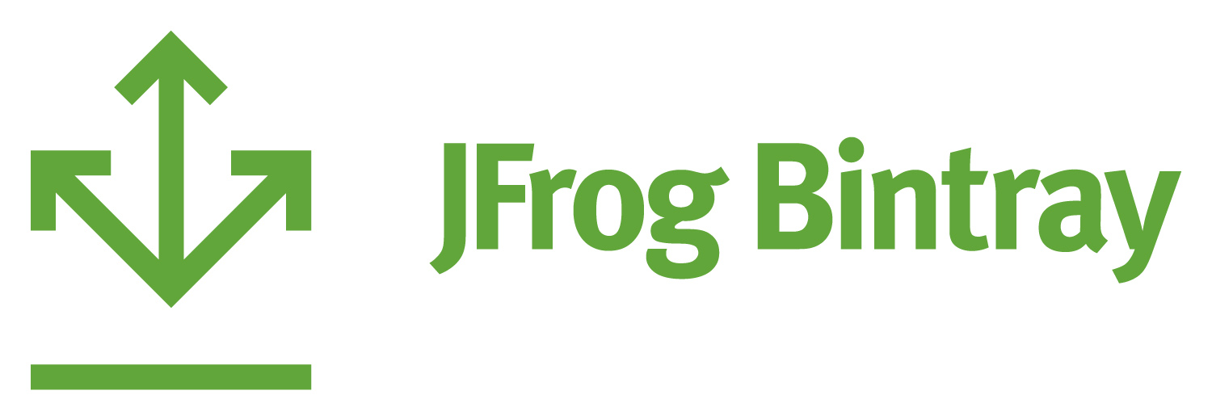

Slide 11


Slide 12

Poll Time!
Docker
Docker everywhere

Slide 13
Poll Time!
Heard about Docker
Can do the tutorial
PoCing, playing etc.
Production, baby!

Slide 14

Y u no
Docker production?

Slide 15

I like you
But I don’t trust you

Slide 16
Continuous integrity.

Slide 17
JFrog Artifactory + Docker

Slide 18

Artifactory as docker Registry

Slide 19
Artifactory as docker Registry
- High availability

Slide 20
Artifactory as docker Registry
- High availability
- Proven and powerful security model

Slide 21
Artifactory as docker Registry
- High availability
- Proven and powerful security model
- Integration with Enterprise systems

Slide 22
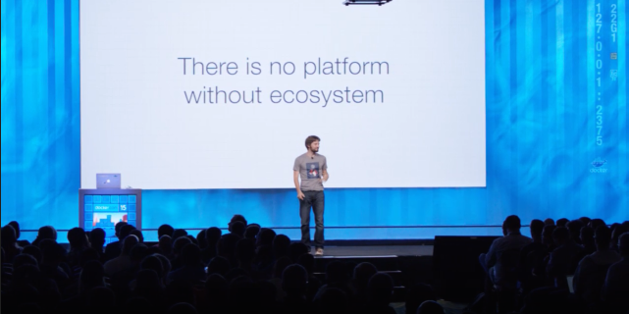
Who’s using Docker and nothing else?
Notes:
Solomon Hykes

Slide 23
Artifactory as docker Registry
- High availability
- Proven and powerful security model
- Integration with Enterprise systems
- Works with almost everything

Slide 24
Artifactory as docker Registry
- High availability
- Proven and powerful security model
- Integration with Enterprise systems
- Works with almost everything
- browse docker images

Slide 25
Artifactory as docker Registry
- High availability
- Proven and powerful security model
- Integration with Enterprise systems
- Works with almost everything
- browse docker images
- Multiple repositories

Slide 26
The Promotion Pyramid
Prod
Pre-Prod
Staging
Integr. tests
Build/Deploy time
Dev Integration tests
Amount of binaries
Development builds
Amount of builds

Slide 27
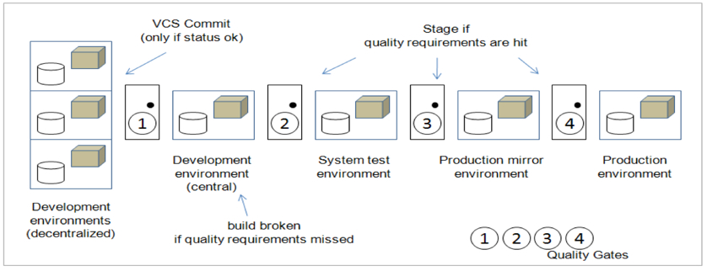
Pipeline: Quality Gates and Visibility
Source: Agile ALM, Michael Hüttermann, Manning Publications Co.

Slide 28
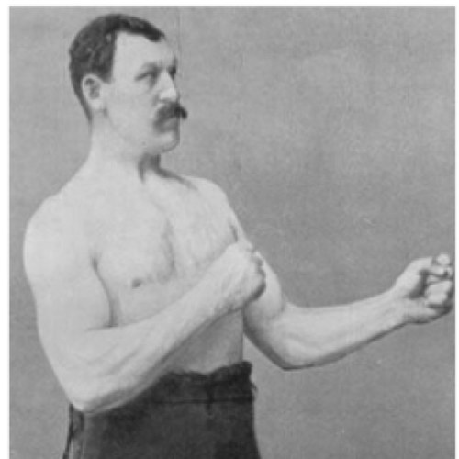
CI pipelines?
Doing them for years.

Slide 42

$docker build

Slide 43

Docker build
All the things!

Slide 44
Too easy!

Slide 45
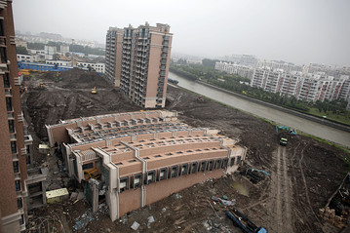
Fast and cheap builds
Not always the way to go

Slide 46
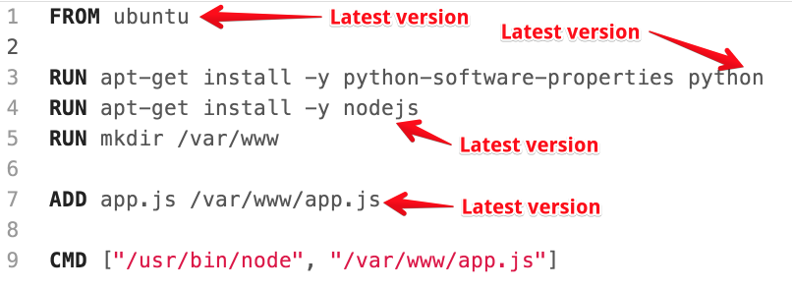
That’s why.

Slide 47

I don’t always build promotion pipelines
But when I do, it’s with immutable and stable binaries

Slide 49
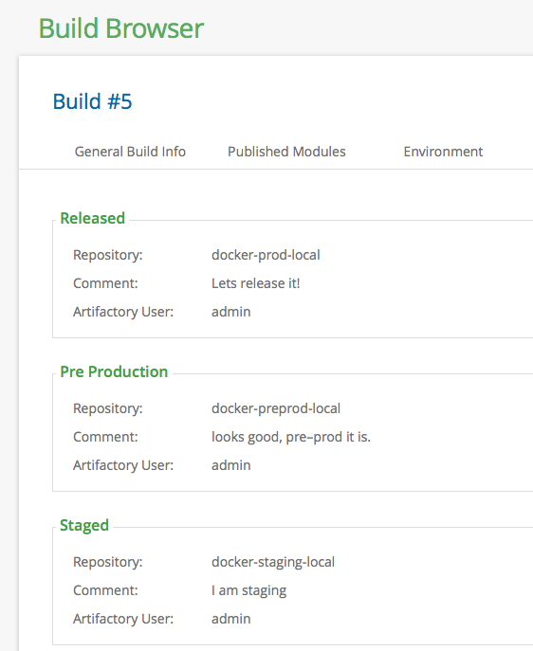

Slide 50

Trumped-up limitations

Slide 51
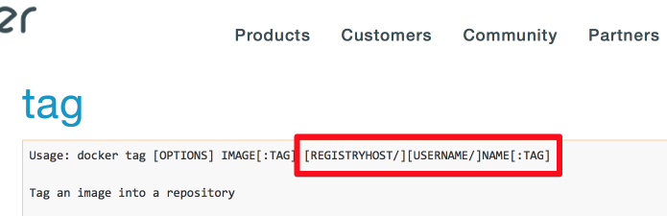
The Anatomy of Docker Tag

Slide 52

Wait a second, how can I have more than one repository per host now?!

Slide 53
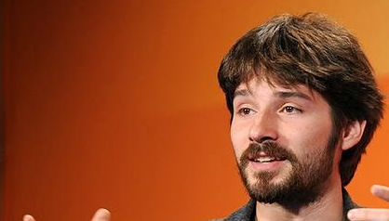
“One registry per host ought to be enough for anybody.”

Slide 54

Panic!

Slide 55


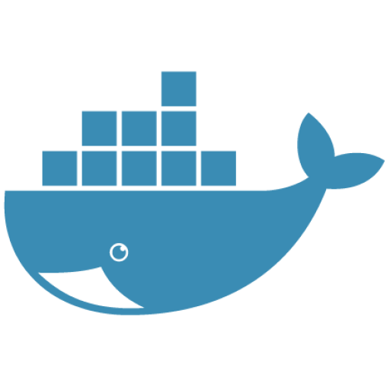
Artifactory Virtual Repositories
Local Repository
Virtual Repository
Remote Repository
Docker Hub

Slide 56
What we did?

Slide 57
What we did?
- Minimize number of repositories docker interact with

Slide 58
What we did?
- Minimize number of repositories docker interact with
- deploy to virtual (backed by dev repository)

Slide 59
What we did?
- Minimize number of repositories docker interact with
- deploy to virtual (backed by dev repository)
- promote within artifactory

Slide 60
What we did?
- Minimize number of repositories docker interact with
- deploy to virtual (backed by dev repository)
- promote within artifactory
- Resolve from virtual (production-ready images)

Slide 61

Virtual Repositories FTW
docker-dev-local
resolve
resolve
Developer
docker-virtual
docker-prod-local
resolve
resolve
docker-hub-remote
resolve
Docker Hub

Slide 62
Virtual Repositories FTW
docker-dev-local
deploy
resolve
resolve
Developer
deploy
docker-virtual
docker-prod-local
resolve
resolve
docker-hub-remote
resolve
Docker Hub

Slide 63
Virtual Repositories FTW
docker-dev-local
deploy
resolve
resolve
docker-virtual
promote
Developer
deploy
docker-prod-local
resolve
resolve
docker-hub-remote
resolve
Docker Hub

Slide 64
Virtual Repositories FTW
docker-dev-local
deploy
resolve
resolve
docker-virtual
promote
Developer
deploy
resolve
docker-prod-local
resolve
resolve
resolve
docker-hub-remote
Customer
resolve
Docker Hub

Slide 65
Virtual Repositories FTW
docker-dev-local
deploy
resolve
resolve
docker-virtual
promote
Developer
deploy
resolve
docker-prod-local
resolve
resolve
resolve
resolve
docker-hub-remote
Customer
?
resolve
resolve
Docker Hub

Slide 66
Virtual Repositories FTW
docker-dev-local
docker-dev-virtual
resolve
resolve
Developer
docker-prod-local
docker-prod-virtual
resolve
docker-hub-remote
resolve
Customer
resolve
Docker Hub

Slide 67
Virtual Repositories FTW
docker-dev-local
docker-dev-virtual
deploy
resolve
resolve
deploy
Developer
docker-prod-local
docker-prod-virtual
resolve
docker-hub-remote
resolve
Customer
resolve
Docker Hub

Slide 68
Virtual Repositories FTW
docker-dev-local
docker-dev-virtual
deploy
resolve
resolve
deploy
promote
Developer
docker-prod-local
docker-prod-virtual
resolve
docker-hub-remote
resolve
Customer
resolve
Docker Hub

Slide 69
Virtual Repositories FTW
docker-dev-local
docker-dev-virtual
deploy
resolve
resolve
deploy
promote
Developer
docker-prod-local
resolve
resolve
resolve
docker-prod-virtual
docker-hub-remote
Customer
resolve
Docker Hub

Slide 70

Question: context name? repo name?

Slide 71
Tag name
Virtual repository name
Context name
https://host:8081/artifactory/docker/busybox
How to convert?
docker tag host:port/busybox

Slide 72

Hmm, but how the --registry-mirror fits in?..

Slide 73
Registry-mirror

Slide 74
Registry-mirror
- instructs docker to ignore the host in tag

Slide 75
Registry-mirror
- instructs docker to ignore the host in tag
- or lack of it

Slide 76
Registry-mirror
- instructs docker to ignore the host in tag
- or lack of it
- It’s still a single URL

Slide 77
Registry-mirror
- instructs docker to ignore the host in tag
- or lack of it
- It’s still a single URL
- and it is set per daemon (client)

Slide 78


Slide 79
Promotion metadata

Slide 80
Promotion metadata
- what to promote (which build)

Slide 81
Promotion metadata
- what to promote (which build)
- where from, where to

Slide 82
Promotion metadata
- what to promote (which build)
- where from, where to
- status (staged, released)

Slide 83
Promotion metadata
- what to promote (which build)
- where from, where to
- status (staged, released)
- user

Slide 84
Promotion metadata
- what to promote (which build)
- where from, where to
- status (staged, released)
- user
- comments

Slide 85
Promotion metadata
- what to promote (which build)
- where from, where to
- status (staged, released)
- user
- comments
- custom metadata!

Slide 86
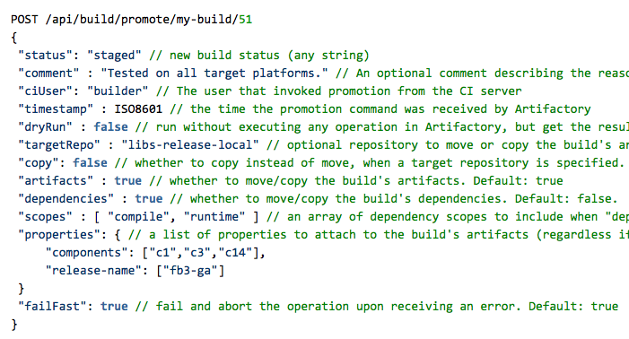

Slide 87
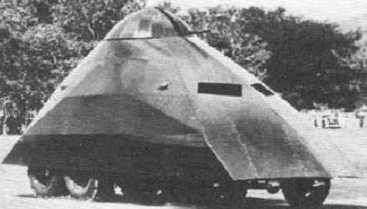
YMMV

Slide 88

Hook your own logic in promotion
I wish I could script it in Groovy…

Slide 89
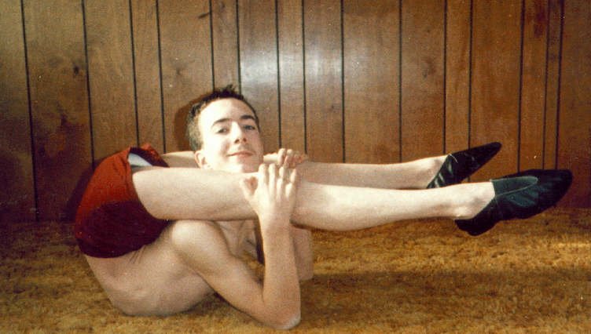
Can your docker registry do this?

Slide 90
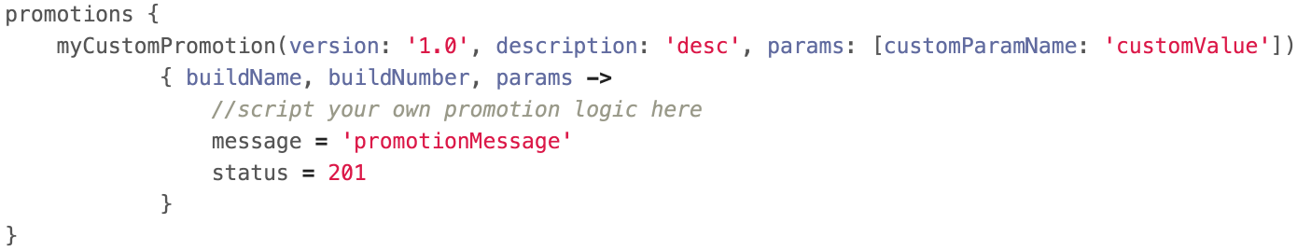

Slide 91

Summary: Automate Everything!

Slide 92

That’s all, Folks!

